Slide 1
Impact of Science Conference the Parallel Session on
Institutional Impact Strategy
23rd June, 2021

Slide 2
Impact of Science
23-25 June, 2021
Overview of the Speakers
Buyinza Mukadasi (Chair): Director of Research and Graduate Training, Makerere University, Uganda
Willie Pearson: Professor of Sociology at the School of History, Technology, and Society at Georgia Institute of Technology, United States
Tracey Dickson: Associate Dean of Research Performance, College of Health and Medicine, University of Tasmania, Australia
Esther De Smet: Senior Research Policy Advisor, Ghent University, Belgium
#IOS21

Slide 3
Impact of Science
23-25 June, 2021
Buyinza Mukadasi
Director of Research and Graduate Training, Makerere University, Uganda
#IOS21

Slide 4
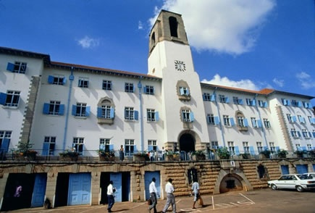
MAKERERE
UNIVERSITY
A CENTURY OF ACADEMIC AND RESEARCH EXCELLENCE
Institutional Impact Strategy
Prof. Buyinza Mukadasi
Director of Research and Graduate Training
Makerere University, UGANDA

Slide 5
Makerere University Background
Mak is a flagship university in East Arica
1922 established as a technical college;
1949 became a University College affiliated to the University College of London;
1963 became one of the Constituent Colleges of EA Univ;
1970 became an independent univ - Act of Parliament;
2011 restructured into a collegiate system –10 colleges;
18 Affiliated institutions;
Ranked 3rd in Research Output & Citation in Africa;
Over 95% of research output in Uganda;
5 Top Publishers in East Africa are from Mak;

Slide 6
CURRENT STATUS
Limited exploitation of S&T innovations by enterprises
Many technological innovations from universities but adoption is low
Universities generally lack technology transfer centres. Technology transfer efforts not well coordinated

Slide 7
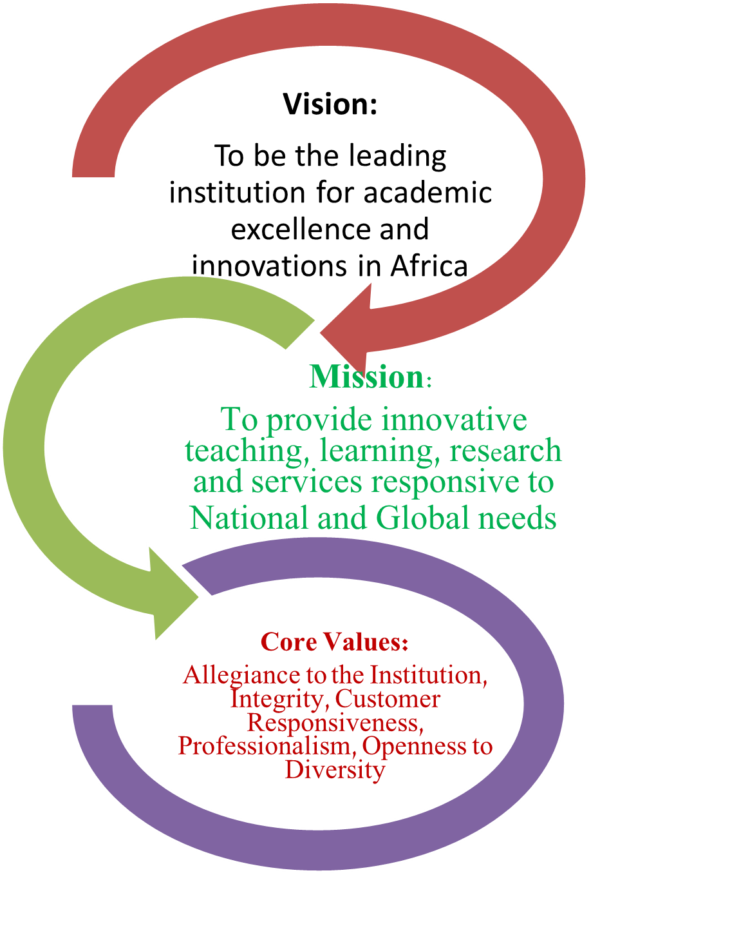
INSTITUTIONAL STRATEGIC DIRECTION

Slide 8
Trends in Institutional Impact strategy setting
Integration of knowledge & disciplines
Citizen participation
Development impact orientation
Partnerships and networking for efficiency and effectiveness
Innovation Systems approach

Slide 9
A holistic approach to successful Institutional impact strategy
Facilitation
Web Presence (20%) webpages hosted in the main webdomain of the university as indexed by the largest commercial search engine
Excellence (15% academic papers published in high impact journals
Openness (15%) institutional research repositories published in commercial engines - google
Impact (15%) academic papers published in high impact international journals
Global Social Responsibility Contribution
Constructive feedback

Slide 10
Framework: Knowledge impact
Modes of Research
Knowledge production
Basic
research
Strategic
research
Applied
research
Experimental
Development
New knowledge
Innovations
Technologies
Knowledge outputs
Knowledge uptake and adoption
Knowledge uptake
Scientific community
Society
Knowledge utilisation
Knowledge impact

Slide 11
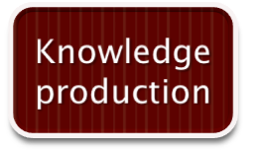
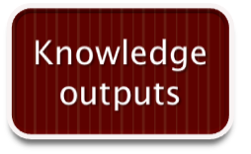
Framework 1 Knowledge uptake and use
Modes of Research
Basic
research
Strategic
research
Applied
research
Experimental
Development
New knowledge
Innovations/ Technologies
New discoveries
theories/ models
New ideas/ hypotheses
New data/facts
Process technologies
Product technologies
Tests/ Scenario’s/ Policies/Designs
Knowledge uptake and adoption
Knowledge uptake
The publics of science and technology
Solutions to problems
Enlightened citizenry
Behavioural change
Evidence-based policy
Improved practice
Knowledge utilisation

Slide 12
Understanding the logic of Institutional Impact Strategy
A current condition perceived as harmful to a client system. A comprehensive description of the environment, resources, behaviours, attitudes, or attributes which are problematic.
Problem
Goals and objectives
Statements of what the programme wishes to achieve (overall purpose)
Resources
Activities
Outputs
Outcomes
What you need to carry out the activities you have planned
What you do with the resources you have
What the activities produce e.g. goods and services
What you expect to happen as a result of the outputs – short and long-term benefits
Indicators
Data sources and Methods
Concrete and measurable “signs” of programme delivery and outcomes
How we gather evidence on the indicators e.g. tests, statistics, questionnaires, interviews, observations, documents

Slide 13
Further explication of “Institutional impact”
Institutional
Systemic impact
Aggregation of effects
Intervention programmes
Outcomes
Benefits
Effects
Outputs
Products
Research programmes
Accumulative effects over time
Target object/Group
Sustained long-term impact

Slide 14
Institutional Strategy “monitoring” and “evaluation”
Description
Evaluation
Ad hoc - measurement
Evaluation criteria:
Effectiveness
Efficiency
Sustainability
Repeated measurement =
monitoring
Performance monitoring
Targets
Inputs
Activities and Outputs
Outcomes/ Effects
Impact
Efficiency
Sustainability
Effectiveness
Target Group/ Beneficiaries

Slide 15
Success factors for recent Mak University- Industry partnerships
Strong and focused research at universities
Availability of public research funding along state priorities
High level commitment to technology transfer within government, private sector and university management
Availability of funding for start-ups
Vibrant entrepreneurship support programmes
Infrastructure and programs for collaborative work between researchers and entrepreneurs.
Reasonable rewards for innovators
Well developed intellectual property management regime

Slide 16
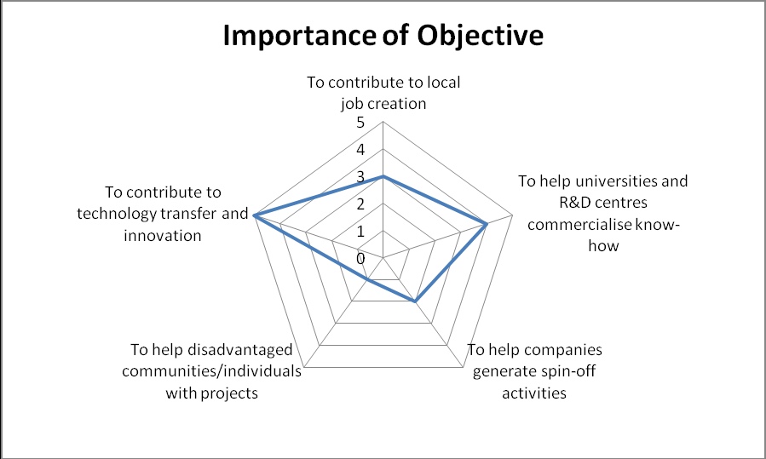
MAK BUSINESS INCUBATORS
Business incubators are programs designed to accelerate the successful development of entrepreneurial companies through provision of support services offered both in the incubator and through its network of contacts.

Slide 17
What has come out of the Institutional Impact Strategy?
Celebrating great achievements

Slide 18
Forging a network of ACEs to support SSA’s development
Cameroon
IT (1)
Rwanda
IT (1); Energy (1) Education (1); Statistics (1)
Senegal
IT (1)
Health (1)
Nigeria
Agriculture (3); IT (1); Extractives (1); Material Science (1); Health (4)
Uganda
Agriculture (2)
Material Science (1) Health (1)
Ethiopia
Agriculture (1); Water (1); Transport (1); Health (1)
Burkina Faso
Water (1)
Kenya
Agriculture (2)
Energy (1)
Tanzania
Agriculture (2; Water (1); Health (1)
Ivory Coast
Agriculture (1)
Statistics (1)
Extractives (1)
Ghana
Agriculture (1)
Water Mgt. (1)
Health (1)
Malawi
Agriculture (1) Health (1)
Benin
Applied Math (1)
Togo
Agriculture (1)
Mozambique
Extractives (1)
Zambia
Extractives (1);
Health (1)

Slide 19
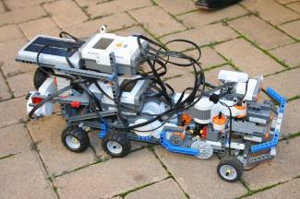
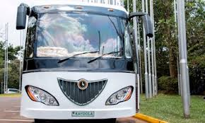
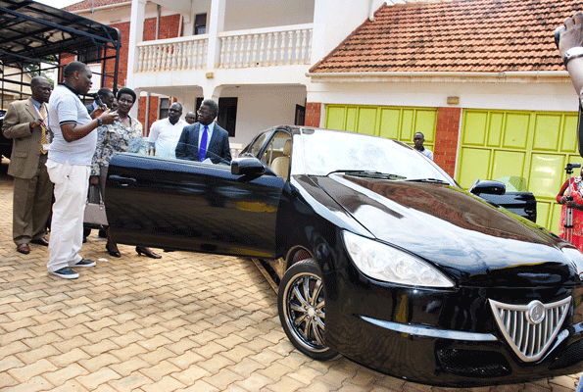
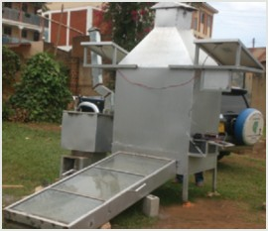
Knowledge Transfer Partnerships
Technology Innovations
Research in Transportation
Maka Pads
Mak 4% share in Kiira EV Company
Energy Efficiency

Slide 20
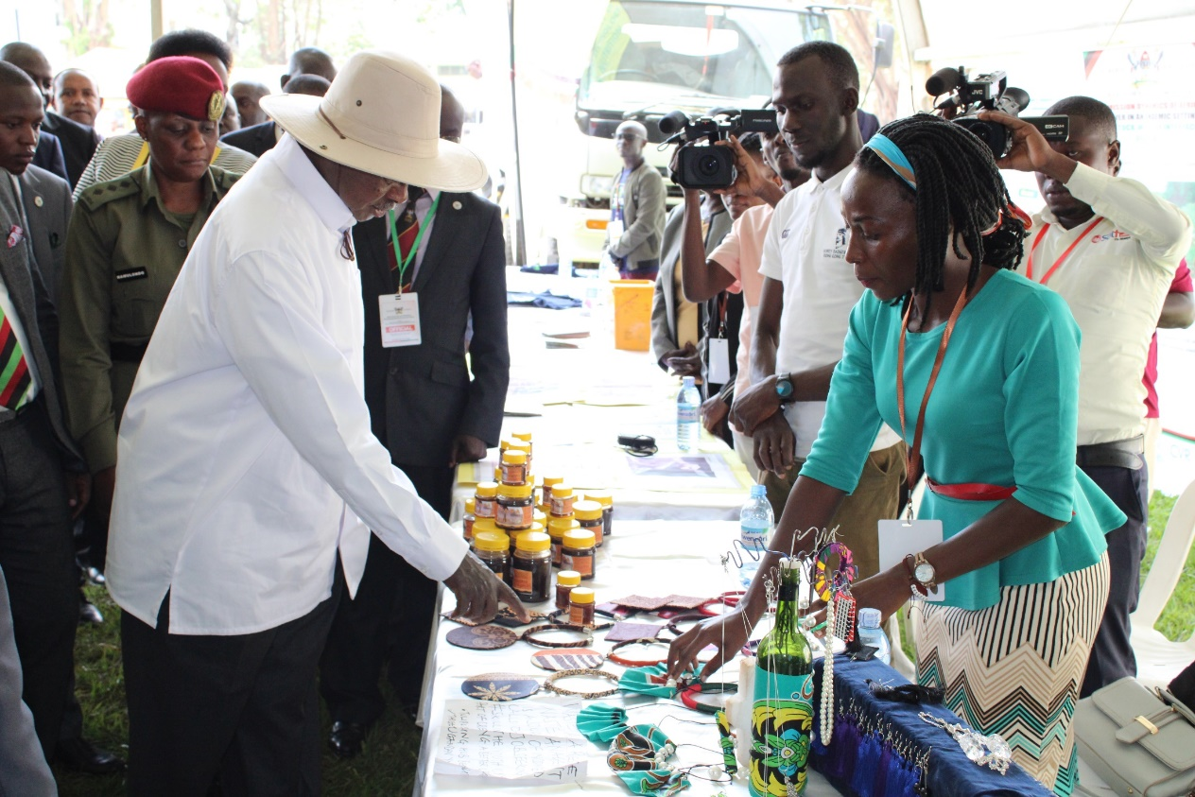
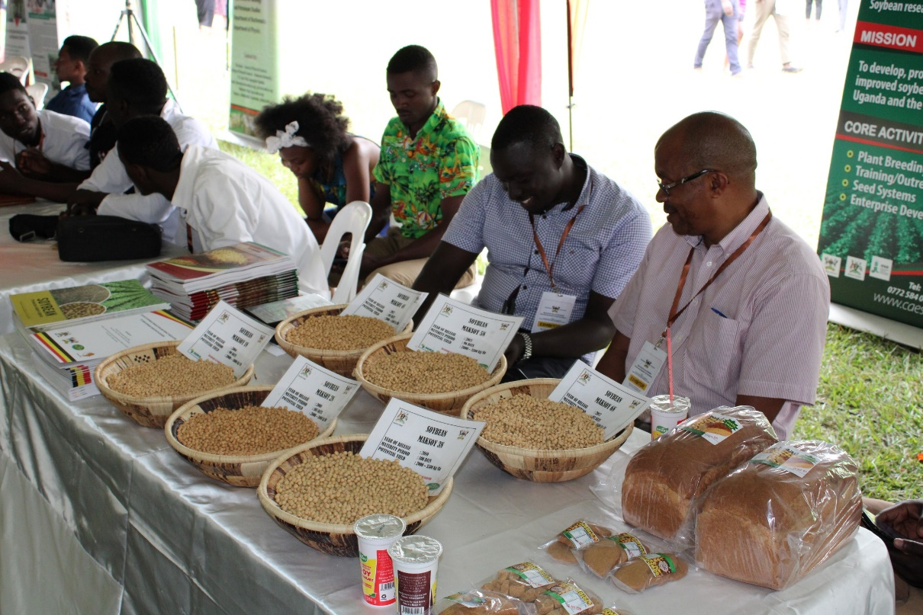
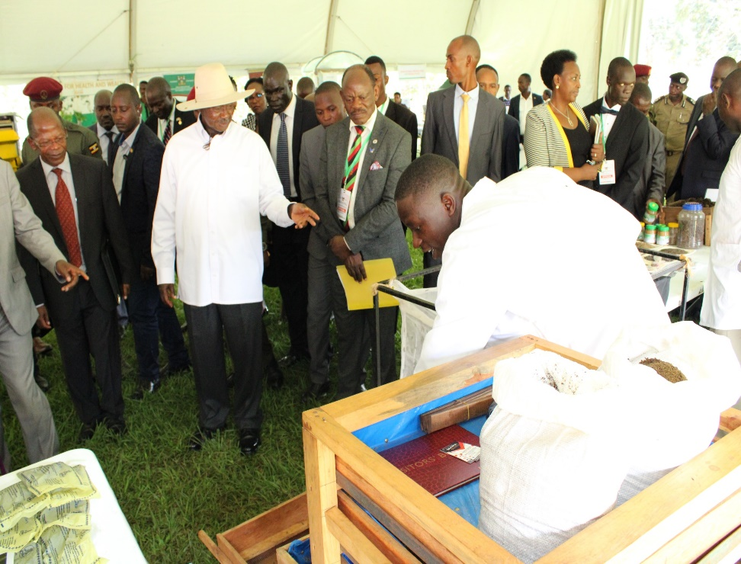

Slide 21
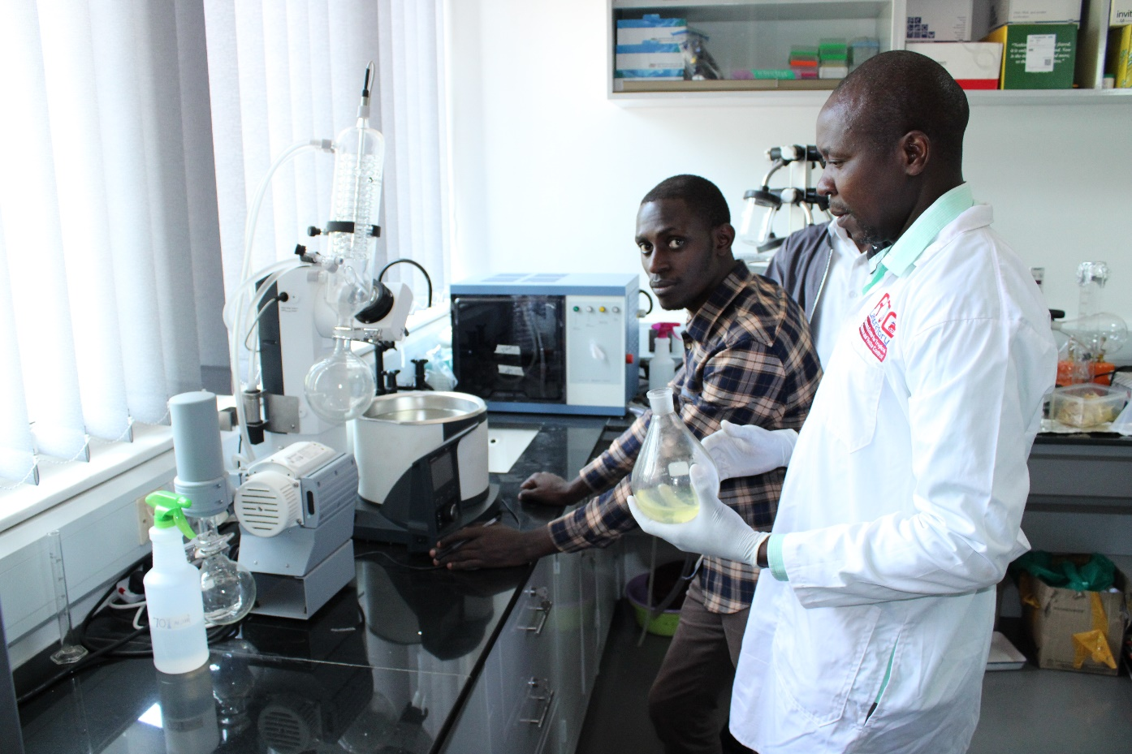
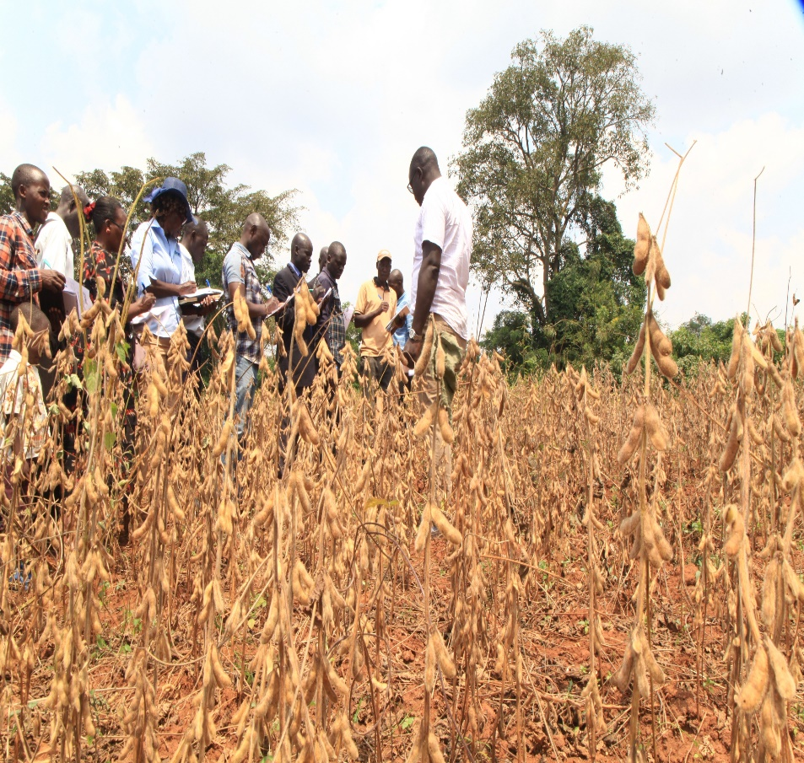
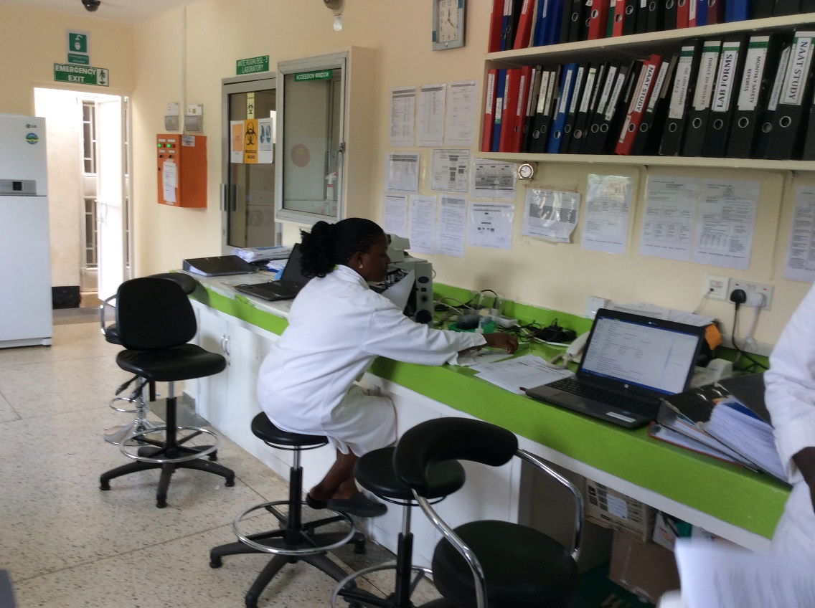
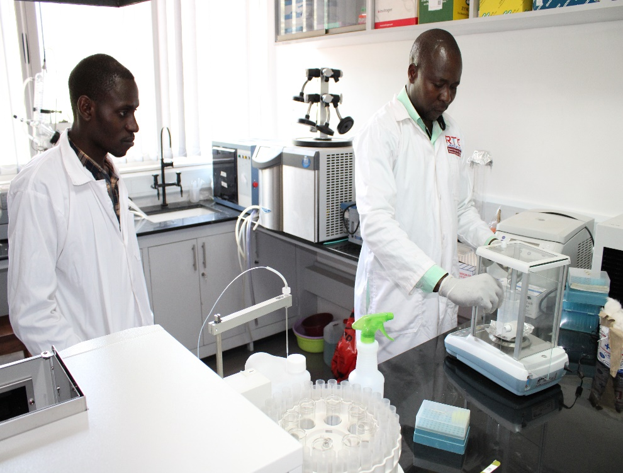

Slide 22
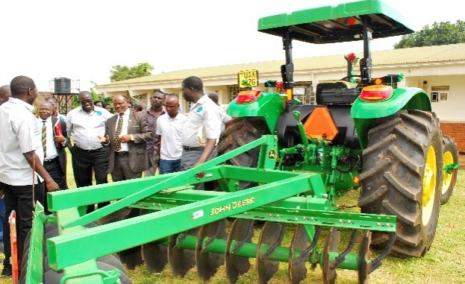
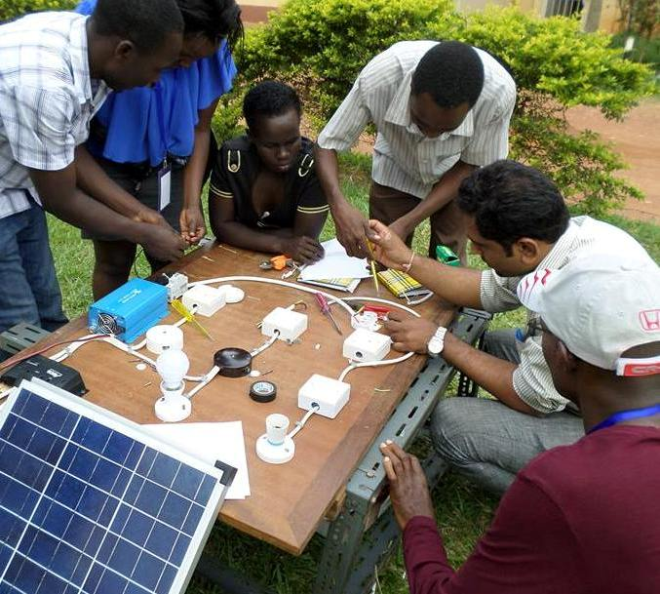
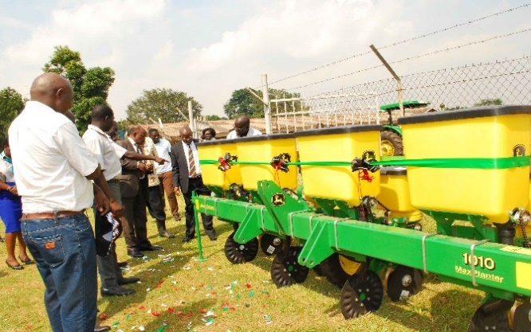
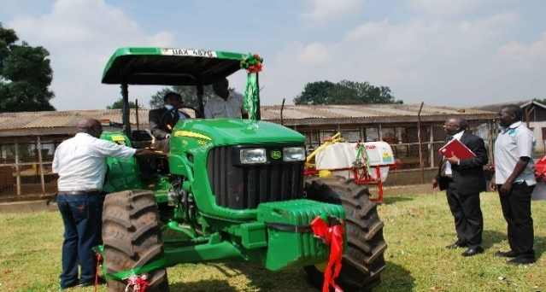
Impactful Research for rural development

Slide 23
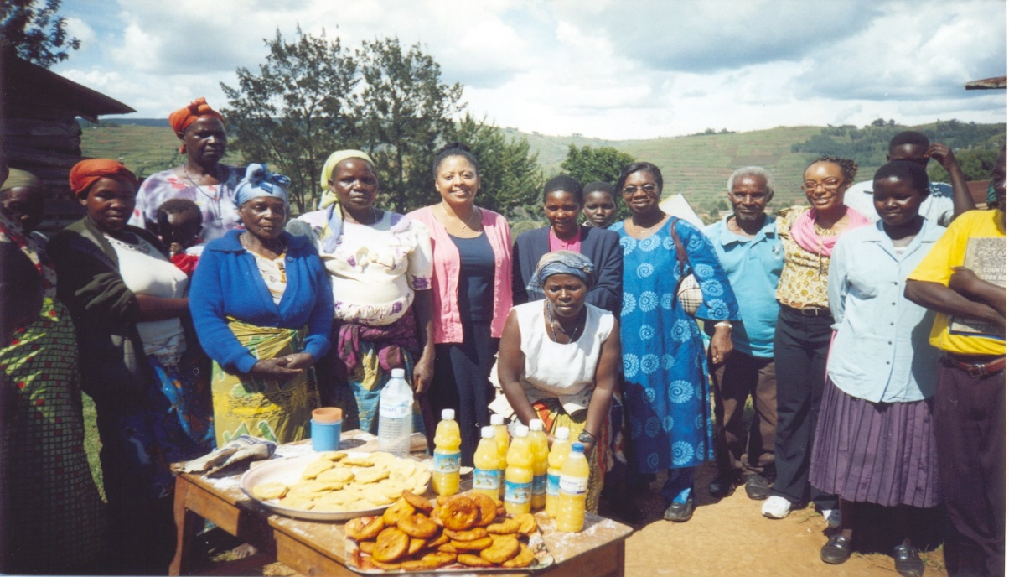
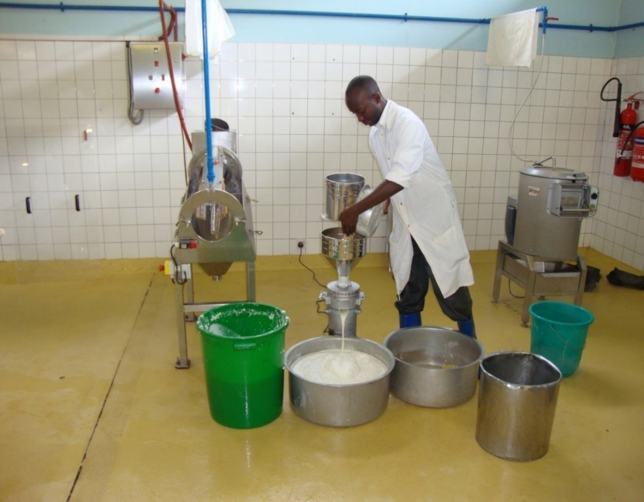
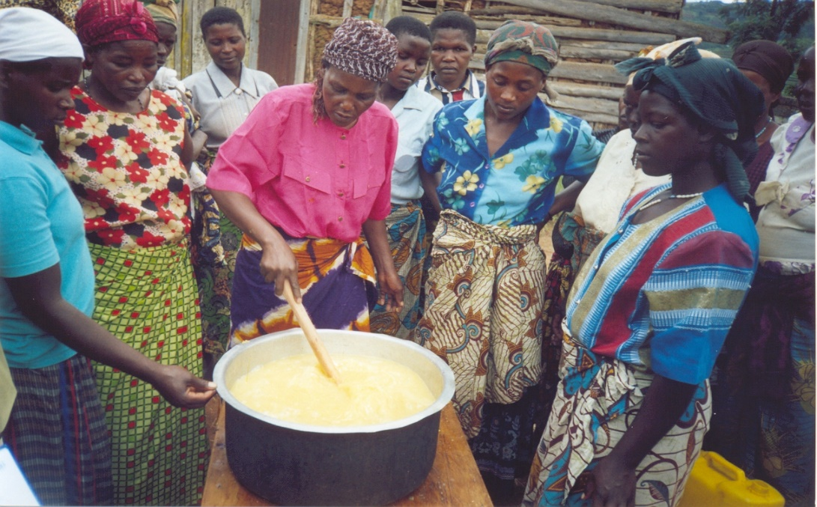
Nutrition and Health education Research

Slide 24
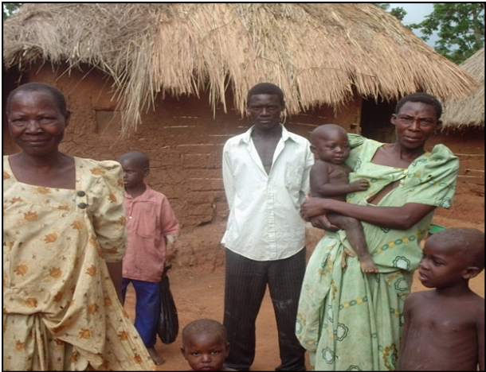
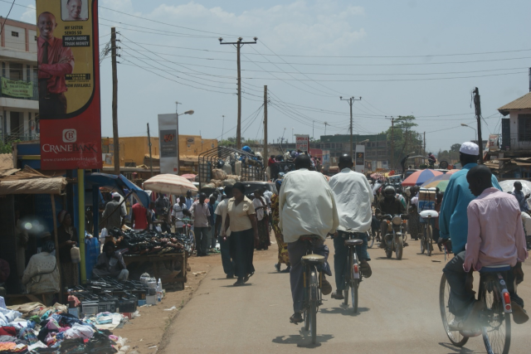
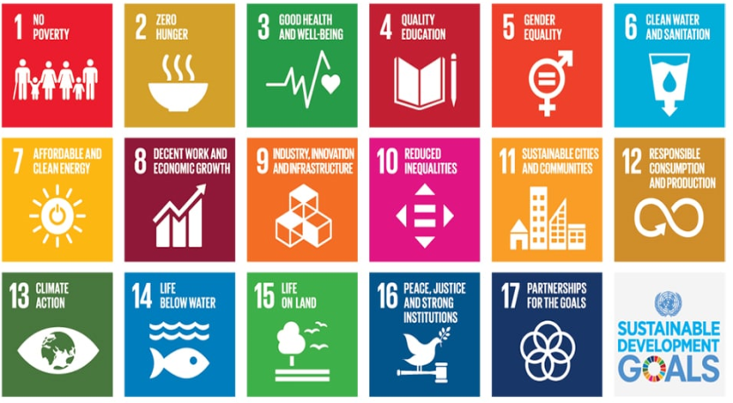
Institutional Impact Strategy from SDG monitoring study
Goal 1- End Poverty
Access to credit by HH (23%)
Availability of social support eg SACCOs (46%)
Few HH benefiting from some Govt Programmes e.g Operation Wealth Creation – 24%
Goal 2 – End Hunger & Achieve food security
Moderate food insecurity – 40%
Severe food Insecurity – 13%
Proportion of HH with local “silos”- 20%
Proportion of HH storing food eg. rice, maize, 40%

Slide 25
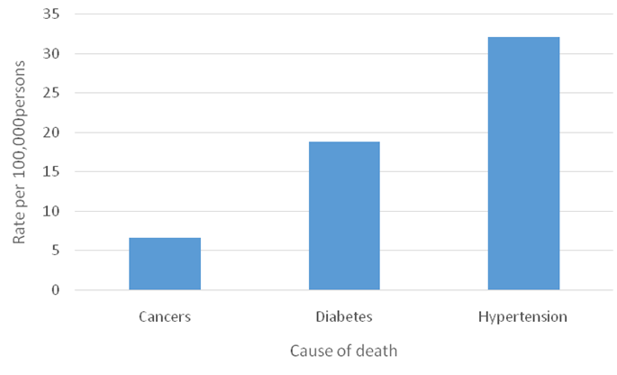
>>>SDG monitoring study
Goal 3- Good Health & Wellbeing
Reduction in IMR since 2007
- Delivery in Health
facilities – 88%
- Proportion of Adults
(>15yrs) with NCDs
increasing

Slide 26
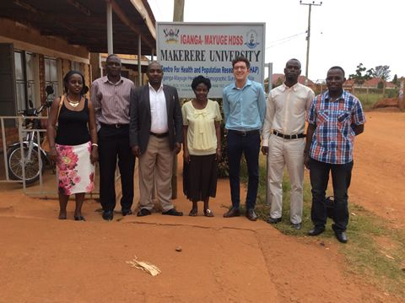
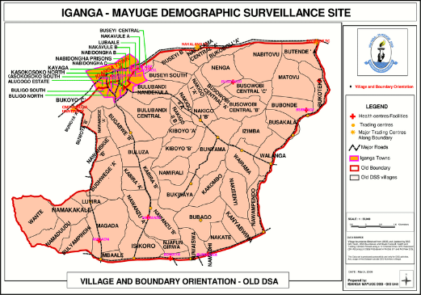
Medical Innovations
Iganga Mayuge DSS; provides a research platform as a public health ‘laboratory’ for community oriented epidemiological and operations research and research training.
Regional Center for Quality of Healthcare (RCQHC);
Medical Education for Equitable Services to All Ugandans (MESAU) – Medical Schools;
Infectious Diseases Institute (IDI);

Slide 27
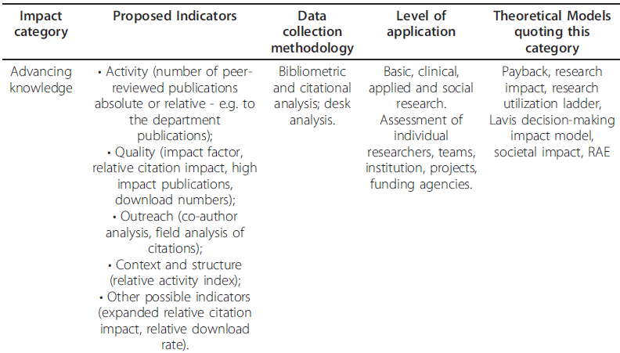
Impact category Advancing knowledge

Slide 28
Impact category Capacity building

Slide 29
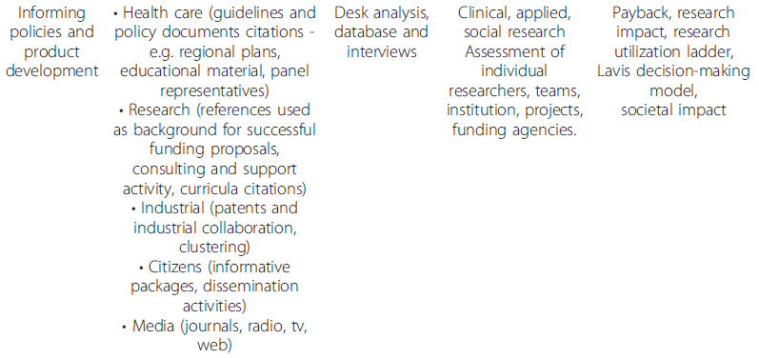
Impact category Informing policies & product development

Slide 30
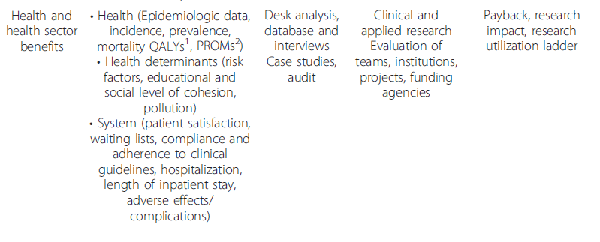

Slide 32
Some early impacts: Research & Innovations Development for social transformation
A. Practical solutions to development challenges through Entrepreneurial cluster approach
New hands-on practical skills acquired e.g Leather processing cluster or textile and garment production , career guidance and training,
Provided arena for application of knowledge acquired in class in field settings-business plans, manage and assess cash flows, management
Transfer of innovative ideas and skills to the businesses such as integrated business ideas that were incorporated in ICT Software cluster, web based marketing strategy
Enhanced the relevance of academia to the private- Industry sector
Boosted the performance and competitiveness of the businesses - reduced operational costs, infusion of innovative and creative business ideas etc
Entrepreneurship and Small business management, to explore various business ideas –60% interest in future engagement in the respective cluster businesses
B. Competitiveness through Innovations and Value addition
Breeding innovations have enabled remarkable reduction in production costs and the increases in expansion of businesses availability of input.
50% of the innovations have been developed through collaborations with the academia
The rest have been indigenously developed, adopted through linkages with other cluster initiatives and other non-cluster relevant stakeholders and partners

Slide 33
Early wins>>
C. Women empowerment
Female dominated clusters- 80% of women-basketry, mushroom, textile- now do business full-time
-before-50% mushroom and Garment and Textile Clusters.
Other Clusters -Fish farming cluster
-availability of and access to input, specifically fish fry
- collective labour under the cluster system (collective construction of ponds for new members)
-increased involvement of females entrepreneurs
D. Poverty reduction, job creation and women empowerment supported by baseline
New innovations and expansions helped start up of new firms, inclusion of new members among who are women and youth
Job creation and income generation
poverty reduction impact

Slide 34
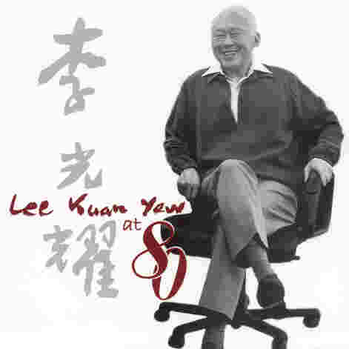
“The higher the skills and expertise, the greater the value that is added to the materials processed. The greater the “added value”, the higher the wages.”
Prime Minister Lee Kuan Yew 1969

Slide 35
Impact of Science
23-25 June, 2021
Willie Pearson
Professor of Sociology at the School of History, Technology, and Society at Georgia Institute of Technology, United States
#IOS21

Slide 36
Racial Awakening in the American Scientific Community: Once Again
Willie Pearson, Jr., PhD
Georgia Institute of Technology
United States
AESIS
July 23, 2021

Slide 37
Introduction
Unlike other social institutions, science has been touted as being relatively free of discrimination because it adheres to the norm of universalism—evaluation and rewards based entirely on merit.
Fraser among others call for dismantling institutions that prevent some groups from equal participation, while privileging other groups.
Marcia McNutt (2020), President of the U.S. National Academy of Science, Engineering and Medicine (National Academies), asserts that before the scientific community can begin addressing inequality, it must first admit that it has been part of the problem.
As a sociologist of science, I have spent most of my professional career arguing this very point. Today, I further the argument.

Slide 38
Purpose
This presentation seeks to enhance understanding of the conditions that continue to fuel the unequal participation of Blacks in the American scientific community.

Slide 39
Representation: S&E Degree Recipients
In 2018 (12.3% U.S. population), Blacks earned:
8.4 bachelors
8.3 master’s
5.5 doctorates
Lower in more quantitative fields.
Only 2.4% of PhD graduates in artificial intelligence (AI).

Slide 40
Representation
40% switched out of S&E majors, compared with 29% of White peers
1.6 times more than Whites to withdraw from or receive D’s, F’s or incomplete grades in S&E “weed-out” courses
Less likely to identify a professor as a mentor

Slide 41
Representation: Workforce (Ages 25 and Older)
Blacks comprise 11% of all employed adults, compared with 9% employed in S&E occupations

Slide 42
Strategies to Increase Representation
Policies
National Science Foundation Proposal Criteria
Intellectual merit
Broader Impacts
Broaden participation: Committee on Equal Opportunity in Science and Engineer (CEOSE)

Slide 43
Strategies to Increase Representation
Programs
Federal agency policies changed the eligibility language of diversity programs in search for race-neutral surrogates

Slide 44
Program Evaluation
Measurable objectives—effectiveness of programs.
Best strategy for providing information on what is effective and what is not.
Provide real-time continuous feedback to guide in design, planning, and implementation.

Slide 45
Implications
Replicating and scaling are problematic—lack sufficient evidence as to what works and under what conditions.
Potential exemplar: (Freeman Hrabowski III)
Meyerhoff Scholars Program and the transformation of the University of Maryland, Baltimore County (UMBC)

Slide 46
Implications
McNutt (2020) called for the creation of…
“a new type of convergence of the natural and social sciences so that the impact of an initiative on people can be anticipated in advance and the project can be modified if necessary to avoid undesirable outcomes.”
Transforming societal and institutional inequality requires a sustained societal commitment rather than an episodic approach following each consciousness-raising racist act.

Slide 47
Bibliography
Bright, D. and Pearson, Jr., W. (2021). “Race, Social Justice, and Higher Education Financial Aid in the United States: The Case of African Americans.” Pp. 149-170 in Pearson, Jr., W. and Reddy, V. Editors. Social Justice and Education in the 21st Century: Research from South Africa and United States. Cham. Switzerland: Springer.
Feagin, J. and Elias, S. (2012). “Rethinking Racial Formation Theory: A Systemic Racism Critique.” Race and Ethnic Studies 36(6):931-960.
Fraser, N. (2008). Scales of Social Justice: Reimaging Political Space in a Globalising World. Cambridge: Polity Press.
Fry, R. Kennedy, B. and Funk, C. (2021). STEM Jobs See Uneven Progress in Increasing Gender, Racial and Ethnic Diversity. Washington, DC: Pew Research Center.
Hrabowski, III, F., Tracy, J. K., and Henderson, P. H. (2020). “At a Crossroads: Reimagining science, engineering, and medicine—and its practitioners.” PNAS 117 (31): 18137-18141.
Ladyzhets, B. (2020), These 6 graphs show that Black scientists are underrepresented at every level. Science News Dec. 16, https://www.sciencenews.org).

Slide 48
References Cont’d
Leggon, C. and Pearson, Jr., W. (2012). “Assessing Programs to Improve Minority Participation in the STEM Fields,” Chapter 11 in R. Ehrenberg and Kuh, C. V., Doctoral Education and the Faculty of the Future. Ithaca: Cornell University Press.
Leggon, C. B. and Gaines, M. S., (2017). Editors. STEM and Social Justice: Teaching and Learning in Diverse Settings: A Global Perspective. Cham, Switzerland.
Massey, W, E. (1989. Foreword. In Pearson, Jr., W. and Bechtel, H. K., Editors. Blacks, Science, and American Education. New Brunswick, NJ: Rutgers University Press.
National Science Foundation (2021). Women, Minorities and Persons with Disabilities Alexandria, VA: National Center for Science and Engineering Statistics.
McNutt, M. (2020). Science and Equality of Opportunity. PNAS. 117 (28):16090-91.
National Academies (2011). Understanding Minority Participation: America’s Science and Technology at the Crossroads. Washington, DC: National Academy Press.
National Academies (2020). Promising Practices for Addressing the Underrepresentation of Women in Science, Engineering and Medicine. Washington, DC: National Academy Press.
Pearson, Jr., W. and Reddy, V. (2021), Editors. Social Justice and Education in the 21st Century: Research from South Africa and the United States. Cham, Switzerland: Springer.
Pearson, Jr., W., Frehill, L. M., McNeely, C. L. (2015), Editors. Advancing Women in Science: An International Perspective. Cham, Switzerland: Springer.

Slide 49
References Cont’d
Pearson, Jr., W. (2005). Beyond Small Numbers: The Voices of African Doctoral Chemists. New York: Elsevier.
Pearson, Jr., W. and Bechtel, H. (1989), Editors. Blacks, Science, and American Education. New Brunswick, NJ: Rutgers University Press.
Pearson, Jr., W. (1985). Black Scientists, White Society, and Colorless Science: A Study of Universalism in American Science. Millwood, NY: Associated Faculty Press.
Richardson, K., Clark, Z., Gaines, M. S., Kingi, H., Miller, S., Pearson, Jr., W., and Richard, L. (2018). “Awhina Revolution: A Bayesian Analysis of Undergraduate and Postgraduate Completions Rates from a Programmed for Maori and Pacific Success in STEM disciplines.” CBE-Life Sciences Education. Spring:1-13.
Slaughter, J. B., Tao, Y., and Pearson, Jr., W. (2015), Editors. Changing the Face of Science: The African Experience. Baltimore: The Johns Hopkins University Press.
Suran, M. (2021). “Keeping Black Students in STEM.” PNAS 118 (23): 1-5.
Smart, A. (9-1-2020). After Years of Gaines, Black STEM Representation If Falling. Why? https://Undark.org

Slide 50
Impact of Science
23-25 June, 2021
Tracey Dickson
Associate Dean of Research Performance, College of Health and Medicine, University of Tasmania, Australia
#IOS21

Slide 51
The Tasmanian Societal Impact model
Professor Tracey Dickson
Associate Dean Research, College of Health and Medicine University of Tasmania
23 June 2021

Slide 53
Tasmania in the global context
Notes:
red circle and arrow show where we are in the world and where I am speaking to you from now

Slide 54
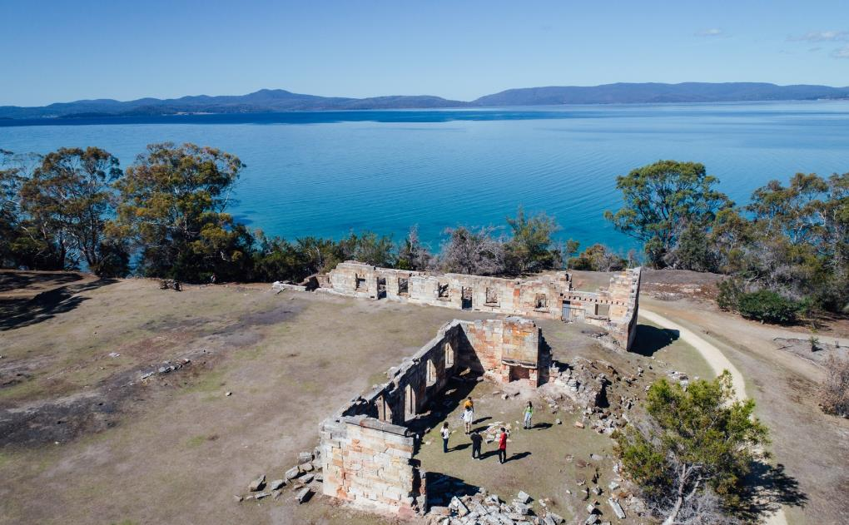
Our vision is…
To make a difference for lutruwita/Tasmania, and from Tasmania to the world, to become one of the very special places on the planet, a place that people can look to as a model for how to create a truly sustainable, equitable and prosperous society while preserving the distinctive qualities that make it such a special place

Slide 55
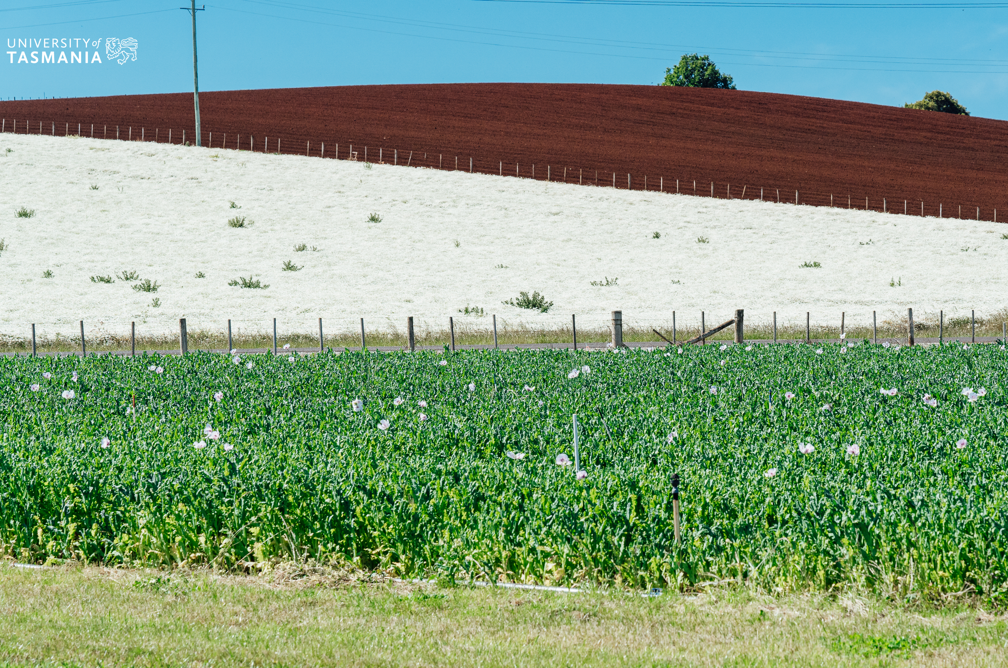
Our place shapes how we
can most effectively amplify impact
Our place-based vision emphasises a focus on partnerships with key external partners - public, private, community, philanthropy.

Slide 56
We have thought deeply about the way our University can make a difference to Tasmania
Skills and education
Development of human capital that enhances productivity and growth
Research
The creation and application of knowledge to support industry innovation, growth and productivity
Civic engagement
The application of our resources to solving the critical challenges and problems that confront Tasmania
Broad impacts on the economy
Our contribution both as a significant industry in Tasmania, and a key enabler to regional economic sustainability via our regional campuses and activities
Surge capacity
Our ability and expertise to mobilise the specialist resources required to compliment and supplement emergency response and recovery
Notes:
Skills and education - development of human capital that enhances productivity and growth
provide the education students need to participate in and help create those parts of the economy that provide good incomes and secure employment, and provide it to as large a proportion of the population as possible;
develop distinctive professional capabilities to meet Tasmania’s particular needs and priorities in all parts of the island;
create regional competitive advantage for key sectors and new businesses through the industry problems we solve;
Research – through the creation and application of knowledge, support industry innovation, growth and productivity to increase
develop from the knowledge created by the University, a strong pipeline of new, rapidly growing, globally competitive but locally based enterprises;
develop the science, engineering and ways of working and living that provide an environmentally sustainable path to inclusive prosperity;
Civic engagement – the application of our resources to solving the critical challenges and problems that confront Tasmania:
create place-based partnerships with all sectors to tackle complex social and economic challenges in an integrated way;
contribute innovative and implementable policy ideas;
enrich our understanding of the unique human and natural history of lutruwita/Tasmania;
give a distinctive creative expression to our identity and ideas.
Economic driver – the university as a major industry in Tasmania, and this includes its contribution to regional economic sustainability via our regional campuses and activities (note this was not included in the strategy narrative around making a difference).
Surge Capacity
Recently mobilised 30 health professionals to support Tasmania response to COVID 19

Slide 57
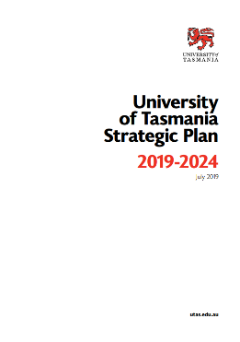
To create a difference in Tasmania, our university strategies focus on having an impact across six key outcome areas we wish to improve
Educational Attainment
Health
Cultural Participation
Increase educational attainment rates across the education life cycle for all population cohorts
Deliver better health and wellbeing outcomes sustainably for all Tasmanians
Increase participation in and contribution to cultural activities
Social Inclusion
Economic Performance
Environmental Sustainability
Improve social inclusion and equity
Lift the economic performance of the State
Improve the environmental sustainability of Tasmania
University of Tasmania Strategic Plan, 2019-2024

Slide 58
To create an impact for and from Tasmania, we aim to impact a number of measures
Outcome Measures
Reduced inequality in Tas (measured through ABS Socio-Economic Index)
Reduced number of people dependent on income support, increased employment
Level of equity and inclusion experienced by disadvantaged communities and groups
Educational attainment
Outcome Measures
Retention of Yr 10-12
# students leaving Yr 12 with ATAR
Attainment of higher education across regions
Increased diversity of cohort
Social inclusion
Outcome Measures
Participation and attendance in cultural events
Number and profile of nationally and internationally recognised artists and authors from Tas
Number of national and international creative industries in state
Increased recognition of economic and social impact of cultural, creative and artistic production through media engagement and financial investment
Participation in sport and physical activity
Outcome Measures
Reduced incidence of chronic health conditions across regions
Efficiency and effectiveness of health system
Improved health equity across Tas communities
Improved health literacy across regions
Access and quality of care available
Cultural Participation
Health
Economic performance
Outcome Measures
Number and value of exports from Tas
Increased level of productivity and average wages
Number of skilled jobs
Environmental sustainability
Outcome Measures
Land - responsible use of agricultural resources and sustainable management of ecosystems
Air - reducing carbon emissions
Sea - preserving oceans, promoting sustainable fisheries and aquaculture, reducing waste and pollution
University of Tasmania Strategic Plan, 2019-2024

Slide 59
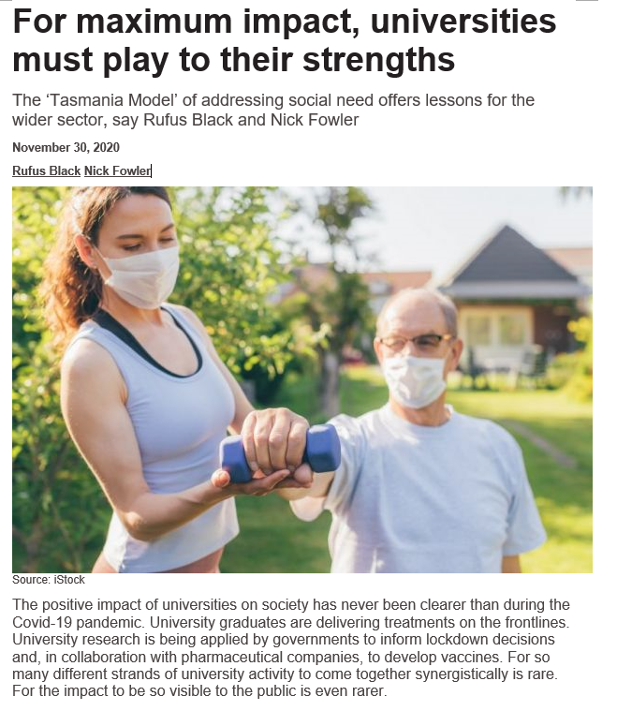
We have been developing an impact-based approach to our research, which Elsevier have chosen to partner with us on
OpEd in Times Higher Education, November 30 2020
Tasmania Impact Model
Provides a chain of logic for amplifying societal impact through a consistent and replicable approach
Identifies tactical and achievable actions we can take across different time horizons, which are then embedded in our strategic plans
Enables us to measure impact and attribution
Times Higher Education: https://www.timeshighereducation.com/blog/maximum-impact-universities-must-play-their-strengths

Slide 60
The Tasmania Societal Impact Model creates a five step process to guide amplifying societal impact
1
Frame the societal problems to solve
2
Calibrate the importance to Tasmania’s future
3
4
5
Assess our ability to influence this problem
Set strategic priorities
Build and implement action plans and measure impact
Understand the current ‘Tasmanian Context’ and supporting baseline evidence / data
Develop the conceptual model of pathways to impact and hypotheses to maximise impact
Frame the scale and scope of our impact intent
Establish trend and benchmark data to identify areas with greatest potential impact for Tasmania
Measure the breadth/severity/ prevalence
Measure current attitudes and behaviours
Collate data on current and planned UTAS activities (L and T, research and engagement) that align with areas
Assess our potential specific and general capabilities (e.g. marketing) that could be applied
Undertake gap analysis and scenario planning
Analyse impact horizons
Agree weightings/values of opportunities and risks to amplifying impact
Agree strength of hypotheses/ scenarios
Apply prioritisation matrix to determine where to focus action
Determine the strategic initiatives (e.g. applying the ‘Research Model’) we will undertake to create highest impact
Consider the inputs/outputs/ outcomes and impacts measures we can attribute to initiatives
Embed in strategic and operational plans
Measure impact and attribution
Establish baseline for measuring and amplifying impact
Amplify and measure impact

Slide 61
We will create a consistent and replicable approach to measuring attribution
Inputs
The resources and capabilities applied to achieve outcomes
Outputs
Indicators of success
Outcomes
What we see as a result
Impact
Broader societal changes
For example:
FTE
# lectures/tutorials
# research applications
# partnerships
Current initiatives
For example:
# graduates
# research publications
# research grants
For example:
Applied knowledge to solve a problem e.g. climate change mitigation
For example:
Cumulative outcomes e.g. improved health and economy
Attitudes -> behaviour -> action i.e. policy change
Activities/ initiatives identified (Step 5)
Baseline established and priority areas of focus identified
Measure level of effort
Measure change
Measure attribution of change

Slide 62
We are creating exemplars in health, environment and education to effectively implement and embed our approach to measuring impact
Workstream
Exemplar components
Health
Societal impact
The change we want to make
How we will make and measure impact
Timeframe for impact
Horizon 1
Hypotheses to change
Activities/initiatives to create impact
Environment
Horizon 2
Horizon 3
Input/output/outcome/ impact measures of attribution
Education
Desired project output
Data modelling visualisation dashboard demonstrating scale of impact

Slide 63
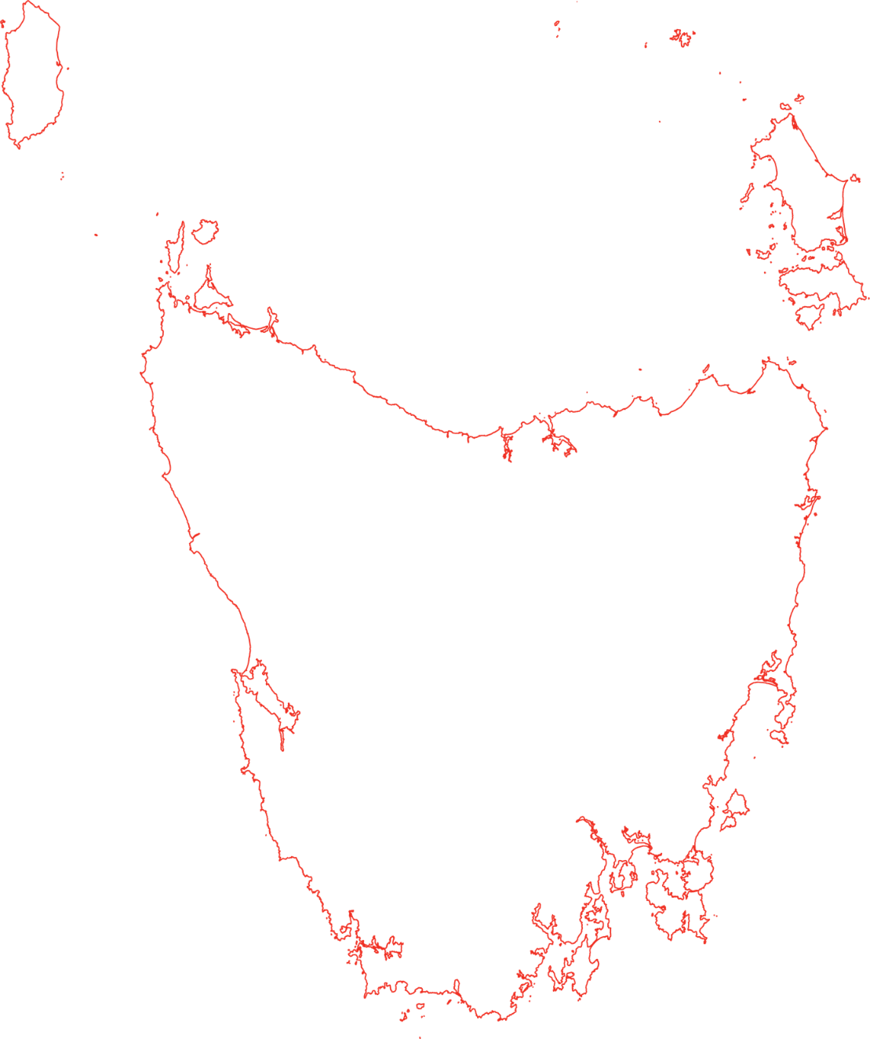
Tasmania is an island community of approximately 535,000
BURNIE
~49,000
Key insights:
The remaining ~41,000 people reside on the West and South-East coasts of Tasmania
98% of Tasmanians live within the ‘inner regional’ or ‘outer regional’ national population categories (2% ‘remote’ or ‘very remote’)
The population is relatively stable
DEVONPORT
~46,000
LAUNCESTON
~146,000
HOBART
~236,000
SOURCE: Regional population growth, abs cat no 3218.0, 2018/19
Notes:
Burnie 19887 Jun 15
Devenport 25 533
Launceston 107000
Greater Hobart approx. 221000
SOURCE: REGIONAL POPULATION GROWTH, ABS CAT NO 3218.0
ABS estimates, 2014-15 Cat. no. 3218.0 - Regional Population Growth, Australia, 2014-15

Slide 64
The North West of Tasmania has consistently higher levels of poor health compared to the North or South
Heart, stroke and vascular disease by selected age groups, 2017-2018
Diabetes mellitis by selected age groups, 2017-2018
Three or more chronic conditions by selected age groups, 2017-2018
Asthma by selected age groups, 2017-2018
Source: ABS National Health Survey, Small Area Estimates, 17-18 (Proportion of Population)
North West
North
Hobart

Slide 65
Tasmania reports significantly higher levels of hypertension than other states
Number and proportion of persons with Hypertension by State, 2017-2018
Key insights:
Tasmania has the highest proportion of hypertension of all states, and higher than Australia overall (10%)
25% Tasmanians aged 18 years and older had a prevalence of high blood pressure (≥140/90 mmHg), the highest of all jurisdictions and higher than for Australia overall (22%)
Hypertension causes ~5 per cent of the total burden of ill-health and premature death in Australia
SOURCE: ABS National Health Survey: First results, 2017-2018 - Australia

Slide 66
We have applied this approach to focus on hypertension, to amplify our collective capability to improve health outcomes for Tasmanians
WORKED EXAMPLE
1
2
3
4
5
Frame the societal problems to solve
Calibrate the importance to Tasmania’s future
Assess our ability to influence this problem/enablers
Set strategic priorities
Build and implement plans, measure impact and performance
Chronic conditions including heart and lung disease, diabetes dementia and mental health conditions are the State’s biggest health issues
Reducing the incidence of these diseases is a strategic priority for the CoHM, the University and the Department of Health
Chronic conditions impact across the six outcome areas
By understanding the breadth, severity and prevalence of the drivers of chronic diseases, we begin to hone in on where we can create greatest impact
We have strong current research capability in these disease areas and in preventative health more broadly, that can be amplified
The Department of Health are critical partners
Our ability to influence requires working together
We must assess our potential specific and general capabilities
A modifiable risk factor that underlies many chronic conditions, and can be targeted over a shorter time horizon is hypertension
Both CoHM and the DHS agree to prioritise this
The NW region will be pilot site, with a view to national scalability and sustainability
A CoHM/DHS lead working group is using joint expertise and evidence to design specific projects
Baseline datasets for each are required so that we can measure impact and performance
Delivery of this suite of initiatives will require us to leverage all of University capabilities
We develop our model of change to create impact
We strengthen our model of change
We deliver our model of change and measure impact
Notes:
Hypertension is the world’s leading single preventable risk factor for death, and causes over 50% of heart disease and stroke
Effective treatment of hypertension reduces death and disability from heart disease and stroke
About 1 in 3 Australian adults have hypertension, but diagnosis is easily missed because it is a ‘silent’ disease (no symptoms)
NW Tasmania has higher levels of chronic disease related to hypertension, poor access to healthcare and high risk for an ill-health trajectory (there is an urgent need to redress this)
Hypertension is easy to screen and treat but only about 50% of adults with hypertension are aware they have it, and only 1 in 7 are adequately treated

Slide 67
We will create impact through work with our partners, the community and across the University
Community
Impact
Partners
University of Tasmania

Slide 68
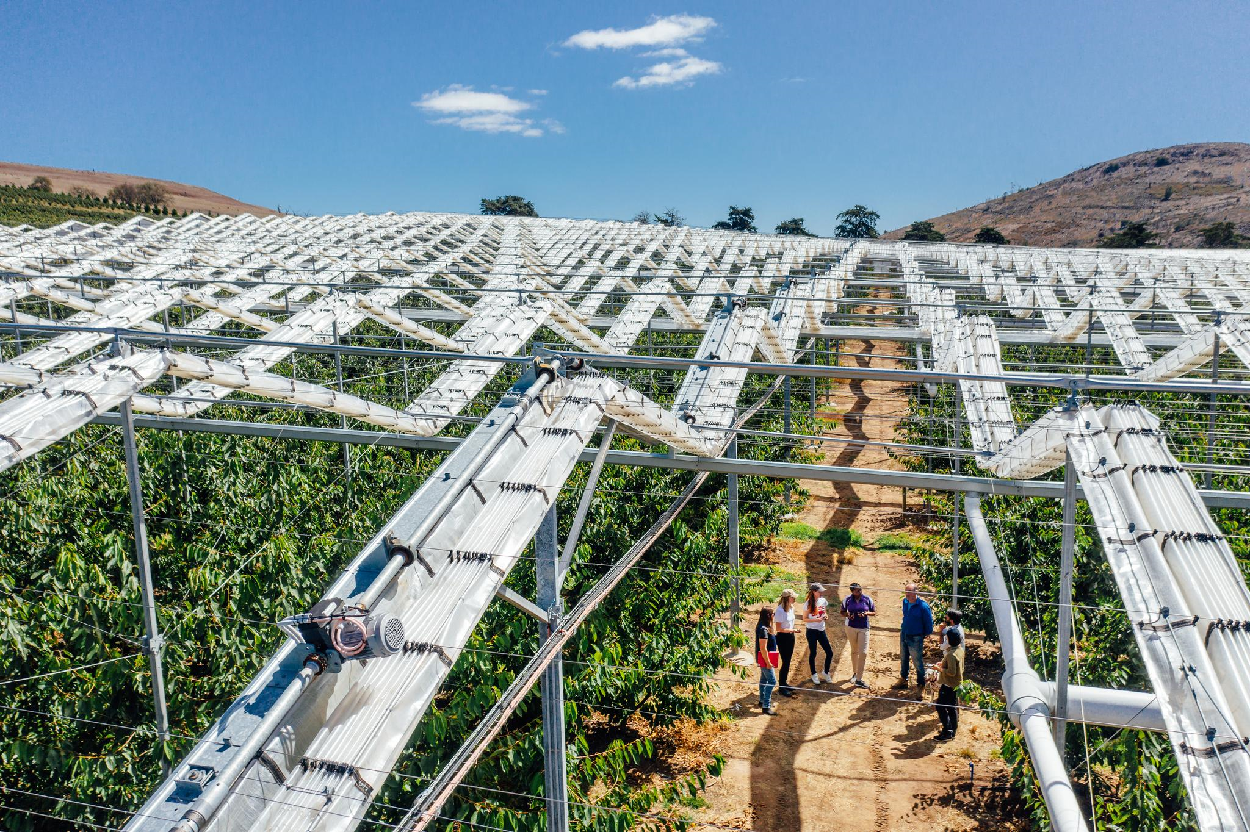
Thank you
Professor Tracey Dickson

Slide 69
Impact of Science
23-25 June, 2021
Esther De Smet
Senior Research Policy Advisor, Ghent University, Belgium
#IOS21

Slide 70
DEVELOPING AN INSTITUTIONAL POLICY FOR
RESEARCH DEPARTMENT
POLICY & QUALITY CONTROL UNIT
SOCIETAL IMPACT
Esther De Smet - Senior Research Policy Advisor @ResearchUGent 23 JJune 2021

Slide 72
HOW READY ARE YOU FOR A POLICY?
INSTITUTIONAL CONTEXT
https://www.emeraldpublishing.com/wordpress/wp-content/uploads/Emerald-Resources-Institutional-Healthcheck-Workbook.pdf
Commitment: strategy, incentives & rewards, funding & support
Connectivity: connected teams, co-ordinated activities
Co-production: support for partnerships & engagement, knowledge on co-creation
Competencies: available expertise, training
Clarity: transparant strategy, transparant support, responsibilities, transparant evaluation
TURNING POLICY INTO SUPPORT
context influences how you support researchers, how you have conversations with them
what in-house services/support/platforms are available? (makes for more feasible proposals)
72

Slide 73
HOW READY ARE YOUR RESEARCHERS?
Building impact literacy
(Phipps & Bayley)
73

Slide 74
GHENT UNIVERSITY
© UGent, Jonas Vandecasteele en Yentl Vandendriessche

Slide 76
Policy
INSTITUTIONAL POLICY ON SOCIETAL IMPACT
People
Platforms

Slide 77
Cherry picking from institutional policy plan (2015)
Roadmap of possible changes (no staff or funds)
Common understanding: valorisation/value creation > impact
Taxonomy of pathways to impact
Link with SSH strategy
Interdisciplinarity, even transdisciplinarity
Open science

Slide 78
Different approach to assessment
Responsible use of indicators and descriptors (signing DORA)
New career and progression model for professors
Group level instead of individual
Case studies: narratives, focus on process & interactions (research in context)
Funding
Separate fund for societal value creation activities
Generic and tailored advice for other funding sources

Slide 79
Impact literacy
Training
Plan ahead, be able to articulate impact
Understand funding requirements
Cf. knowledge brokers (Section on PEOPLE)

Slide 80
(central impact policy advisor)
(Tech Transfer Office)
(Funding units: Development co-operation, EU, but also Flemish and Federal funding…

Slide 81
Research Department
Policy and Quality
Enhancement Unit
Impact policy
Research Co-
ordination Office
Technology
Transfer Office
University Library
EU team

Slide 82
Strategic investment in impact knowledge brokers (IDC)
10 brokers embedded in interdisciplinary research consortia aimed at societal impact
https://www.ugent.be/en/research/science-society/idc
Funded by university’s Special Research Fund + Part of Research Department
Complementary to Business Developers funded by Industrial Research Fund
Separate career model (postdoc)
Evaluation on the basis of (1) pathways to impact and (2) case study approach > inclusion of external review
Community of practice: decentralised network, train-the-
trainer

Slide 83
10 Interdisciplinary research consortia aimed at societal impact (IDC)

Slide 84
Mix of ‘regions of impact’
Importance of local impact and stakeholders
Links with educational policy domain (CSL)
Co-operation with the Global South
University-wide PE & outreach platforms
Extensive scicomm events + collaboration with Sustainability policy
De Krook
Ghent University Museum
(Inter)National networks & projects
Adapted communication (incl. case studies/success stories)

Slide 85
Research information system: making impact activities & expertise visible
E-CV (reusable data)
Altmetric

Slide 86
LESSONS SO FAR
Co-create policy and infrastructure
Group effort
Longterm relationship of trust with stakeholders
Not a big bang but rather a cluster of small revolutions

Slide 87
Esther De Smet
Sr. Research Policy Advisor
RESEARCH DEPARTMENT
E T
esther.desmet@ugent.be
+32 9 264 30 23
www.ugent.be/en/research Twitter: @ResearchUGent (personal: @sterretje8)

Slide 88
Impact of Science
23-25 June, 2021
Thank you
#IOS21

